Slide 1




Email-Spam Detection Project
By Khushboo Khatri

Slide 2
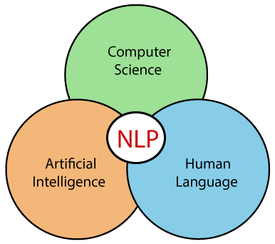

Introduction
1
2
1. We get a collection of data in which with the help of NLP we need to build a Email Spam Detection Model.
2. Spam Filtering/Spam Detector is used to detect unwanted, malicious and virus infected texts and helps to separate them from the nonspam texts. It uses a binary type of classification containing the labels such as ‘ham’ (nonspam) and spam. Application of this can be seen in Gmail, where it segregate spam folder from inbox.

Slide 3
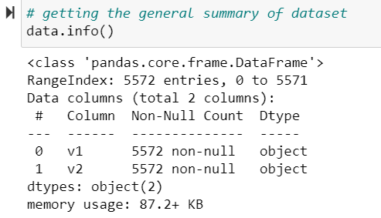
DataSet Description.
We get a csv file which contain one message per line. Each line is composed by two columns: v1 contains the label (ham or spam) and v2 contains the raw text.
There are a total of 5572 rows and 2 columns in our dataset.
Both the columns are categorical in nature, where we need to encode the label for final model building.
And for feature text column we need to perform NLP preprocessing and algorithms to make it model ready.

Slide 4
What is NLP?
NLP enables computers to understand natural language as humans do. Whether the language is spoken or written, natural language processing uses artificial intelligence to take real-world input, process it, and make sense of it in a way a computer can understand.
There are two main phases to natural language processing: data processing and algorithm development..
Notes:
When conducting research, it is easy to go to one source: Wikipedia. However, you need to include a variety of sources in your research. Consider the following sources:
Who can I interview to get more information on the topic?
Is the topic current and will it be relevant to my audience?
What articles, blogs, and magazines may have something related to my topic?
Is there a YouTube video on the topic? If so, what is it about?
What images can I find related to the topic?

Slide 5
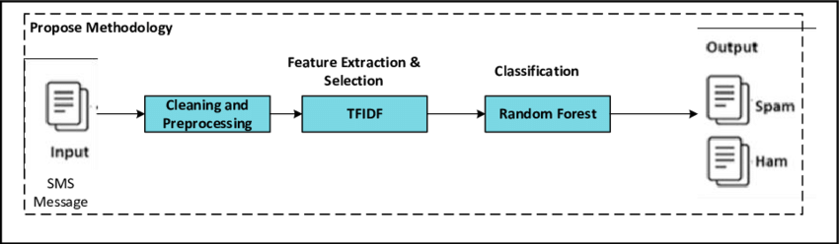
Methodology Followed For the Project.

Slide 6
Pre-Processing and Data Cleaning.
Since we got text feature to work with, following are the steps taken for data cleaning and pre processing the data.
Once we got the data it is always a good option to check for any null values in or not, if no null values are present we are safe to proceed.
We add a new feature name text_length to check the length of each text in v2 column.
Then we import all the necessary libraries required for the pre processing purpose.

Slide 7
Continue…. Pre processing
4. We define a function named ‘deconstructed’ to expand all the English language contractions. (It helps in tokenization)
5. Defining Stop_words and lemmatizer.
6. Then we pass our text data to this function, then we clean the data by remove all the hyperlinks, emails, numbers, punctuations, whitespaces, stop_words, special characters.
7. Then we perform lemmatization, and convert the entire text to lower case.
8. We perform above two steps on our text feature column and store the data into list.
9. We assigned this processed_data list to the feature column v2 of our dataset.
10. Then we check the length of clean data, so that we get a clear idea about how much our data is processed.

Slide 8
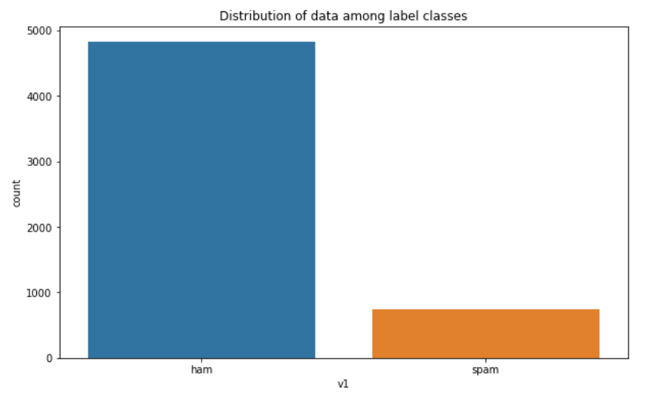
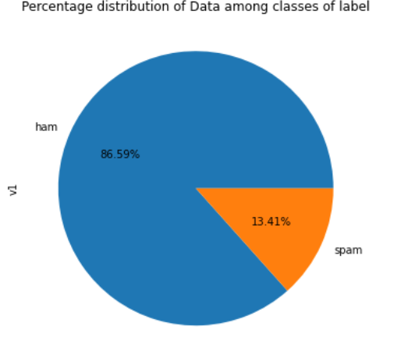
Visualization (EDA)
From above plot, it is clear that there is uneven distribution of data among the classes of label. Around 86.59% of data is for ham while 13.41 % of data is of spam.

Slide 9
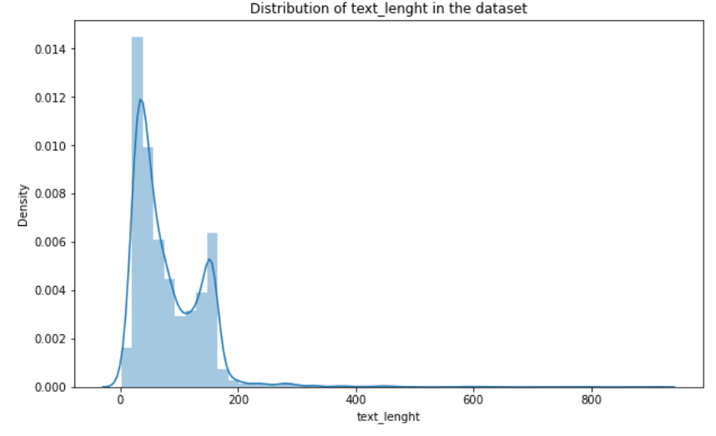
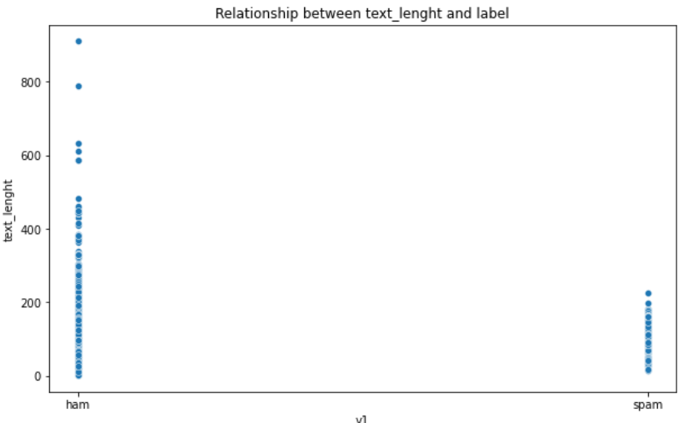
From above plot we tries to visualize the text length for the data we have. We observe that most of the text are of 0-200 words, there were very few which cross this word limit.
In the second plot we tries to see the relation between ham text length and spam text length. It is interesting to see than a spam text will never cross the word limit of 200 words in our case. While those large text are ham only.

Slide 10
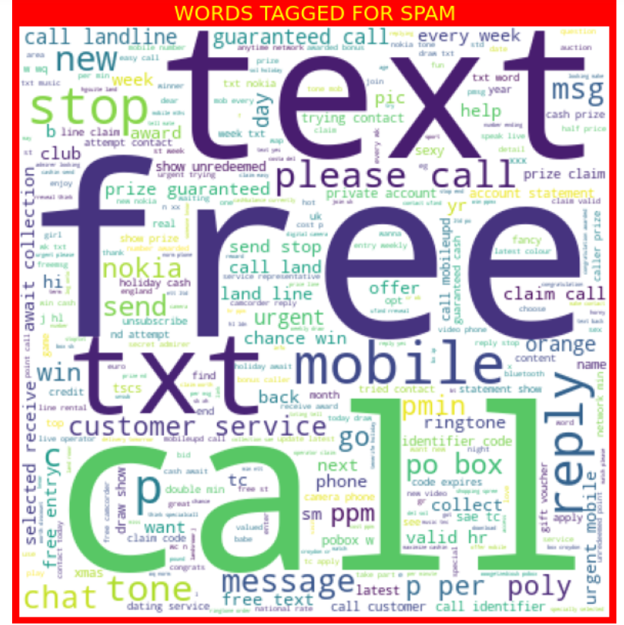
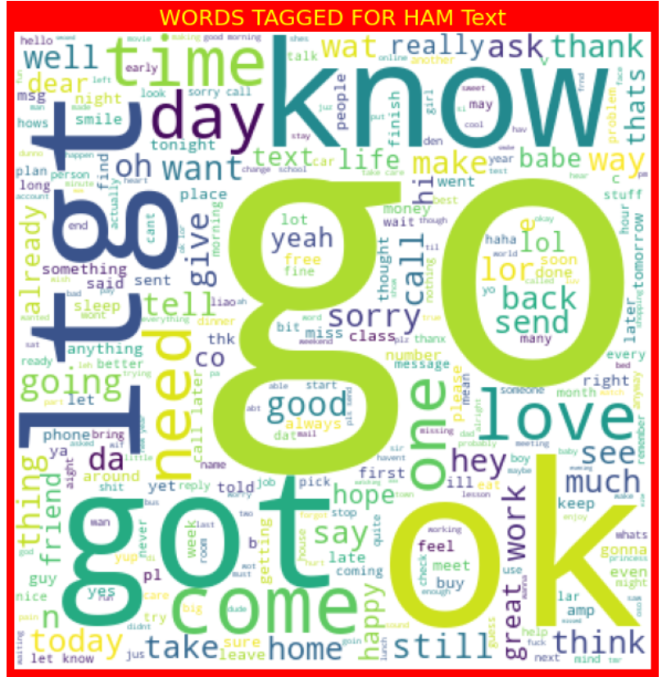
From above wordcloud we can visualize most appearing words in spam text in the left and ham text in the right, It can be observe that word free , call, text are the most widely used words in the spam messages among with others.

Slide 11
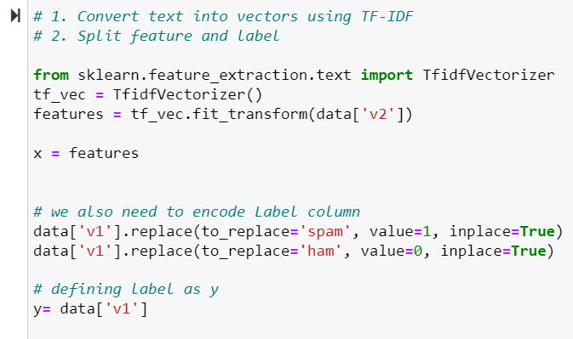
Vectorization and Encoding
We perform TFIDF vectorization on our pre processed data, which convert the text into machine understandable vector form.
And for label data encoding we use simple replace technique, where we replace ‘ham’ with 0, and ‘spam’ with 1.
Since now our data is machine ready, let’s go ahead with model building.

Slide 12
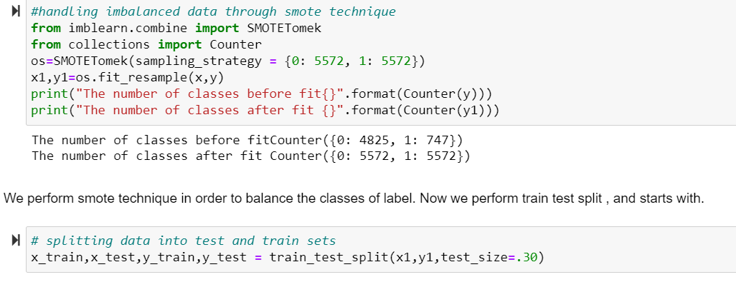
Model Building
Since our label classes are imbalanced , first we balanced our dataset using SMOTE technique. And then we split the entire dataset into train set and test set to perform various algorithms.

Slide 13
Approaches/Algorithms Evaluated
Logistic Regression
Naïve Bayes (MultinomialNB)
DecisionTree Classifier
Random Forest Classifier
SVC

Slide 14

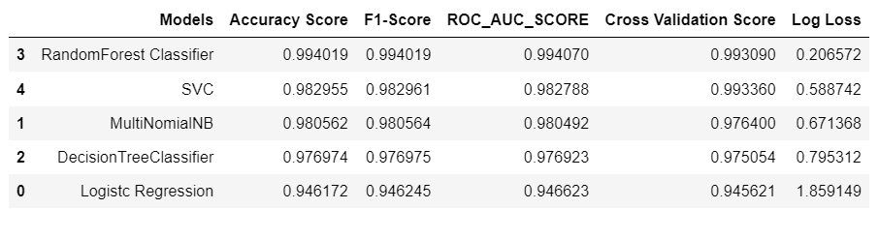
Summary of Each Algorithm.
From above it is clear that randomforest classifier performs really well for our dataset. It has both highest accuracy and lowest Log_loss.
Its cross validation score is also high as well as F1 score is also higher than rest of the algorithms.
Notes:
Once you find your sources, you will want to evaluate your sources using the following questions:
Author:
Who is the author?
Why should I believe what he or she has to say on the topic?
Is the author seen as an expert on the topic? How do you know?
Current:
How current is the information in the source?
When was the source published?
Is the information out-of-date?
Accuracy:
Is the content accurate?
Is the information presented objectively? Do they share the pros and cons?

Slide 15
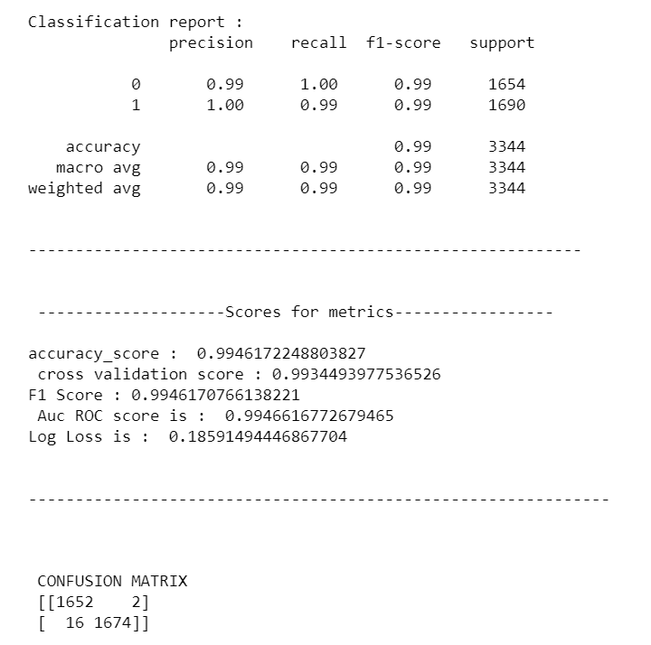
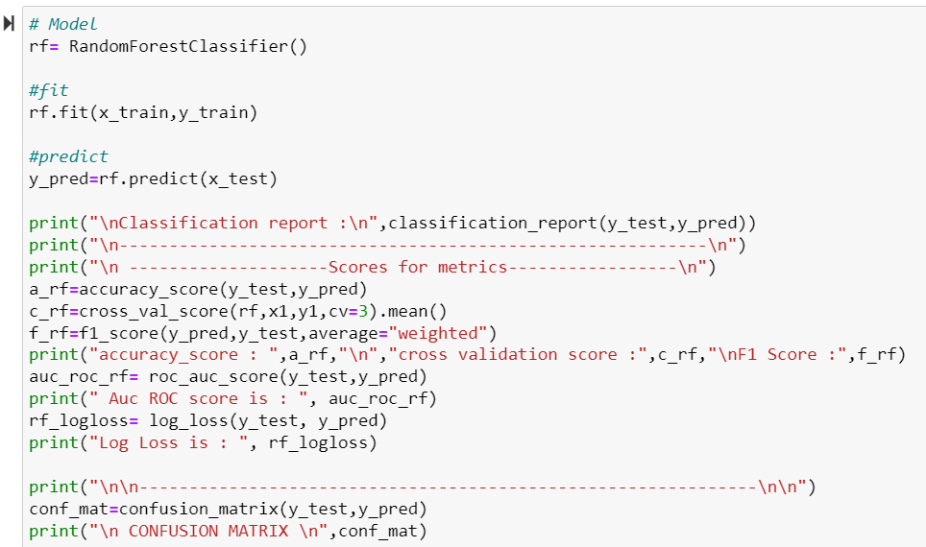
RandomForest Classifier

Slide 16
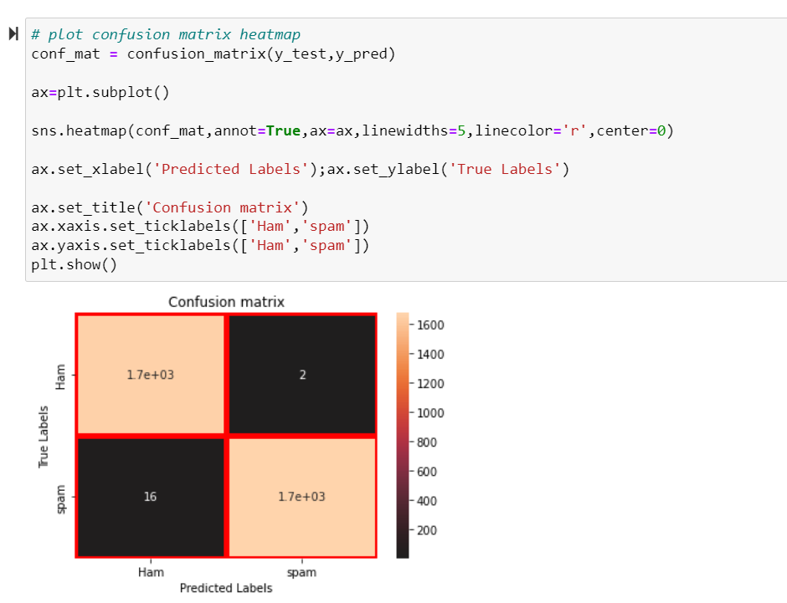
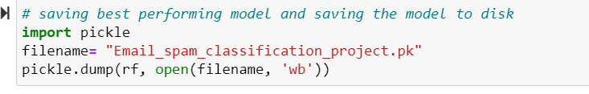
RF Classifier confusion matrix & Model saving

Slide 17
Interpretation of the results
1. Done all the pre-processing steps to make data ready for model building.
2. Removed stop words and create another feature ‘clean_length’ for comparing cleaned and unprocessed message length.
3. Understood relationship and gain insights by using Data Visualization:
a. Plotted count plot for checking spam and non-spam email counts.
b. Lastly, visualize some popular terms in spam messages using the word cloud.
4. Used Tf-idf vectorizer to convert text into vector.
Notes:
After consulting a variety of sources, you will need to narrow your topic. For example, the topic of internet safety is huge, but you could narrow that topic to include internet safety in regards to social media apps that teenagers are using heavily. A topic like that is more specific and will be relevant to your peers. Some questions to think about to help you narrow your topic:
What topics of the research interest me the most?
What topics of the research will interest my audience the most?
What topics will the audience find more engaging? Shocking? Inspiring?

Slide 18
Continue…..interpretation
5. Found the best model as RandomForest Classifier which provides max accuracy of 99.46%.
6. Found high precision and recall score of 0.99.
7. Confusion matrix shows high classification accuracy with only 16 out of 747 are incorrect.
8. Overall model fit is good.
9. We finally save the model using pickle technique so that we can use it for further prediction.

Slide 19
Conclusion
Today, spamming mails is one of the biggest issues faced by everyone in the world of the Internet. In such a world, email is mostly shared by everyone to share the information and files because of their easy way of communication and for their low cost. But such emails are mostly affecting the professionals as well as individuals by the way of sending spam emails. Every day, the rate of spam emails and spam messages is increasing. Such spam emails are mostly sent by people to earn income or for any advertisement for their benefit. So our model is build in such a way so that it can detect the spam and ham mails, from the data.
The best fitted model for our dataset is TFIDF vectorized Random Forest Classifier. It has both highest accuracy and lowest log loss.
Even the roc_auc_score of randomforest is highest of all 99.40%
Notes:
Now, that you have narrowed your topic, you will want to organize your research in a structure that works. There are some common organizational patterns based on the kind of research you are doing.
Organizational Structures:
Cause and Effect- this kind of structure is great for explaining the causes and effects of a topic
Compare and Contrast- in this pattern you highlight the similarities and differences of the topic
Explain process- this structure is great for outlining a series of steps to follow;
Definition- if you want to make sure your audience understands what something is using illustrations, meanings, clarifying misconceptions, you may want to use this structure
Classification- a common organizational structure is grouping like topics or facts from the research together. For instance, in the internet safety about social media apps, you may organize the research where you look at each social media app one at a time

Slide 20
Thank you
Notes:
After you’ve done your research, it’s time to put your presentation together. The first step in the process is to introduce the topic. This is a great time to connect your topic to something that your audience can relate. In other words, why should they listen to all the information you will be sharing in your research presentation? What is in it for them? You may also want to include a graphic or image to grab their attention.
Feel free to duplicate this slide by right-clicking on this slide in the slides pane to the left and select Duplicate Slide.
The next step in your presentation is to state your claim or topic clearly. Your teacher may even call this your thesis. As you state your thesis, you may find that this layout is not the best layout for your claim or topic. You can change the layout by clicking the drop-down menu next to the Layout in the Slides menu section. You can choose Two Content, Comparison, or Picture with Caption. Note: A different layout might change the look of the icons on this page.
You will also want to state your facts. You have done the research now share some of the interesting facts with your audience. Facts do not have to be boring; you can communicate facts in a variety of ways by going to the Insert Tab. In the Insert tab you can:
Insert pictures from your computer or online.
Add a chart
Create some SmartArt
Insert a variety of icons to help your facts come to life. Note: You can change the color of the icons by selecting the icon and then click on the Format tab and then Graphics Fill. From there, you will choose a color from the list or choose More Fill Colors to give you more options.
Since this research presentation is a result of your hard work and searching, you want to make sure you support the claims or points in your presentation with facts from your research findings. Make sure you give the author proper credit for helping you share your ideas. If one of your sources has a video that is relevant to your topic, you can add the video as added support. Keep in mind the length of the video and the amount of time you have for your presentation. For a 5 minute speech, the video should be no longer than 30 seconds.
Questions to consider:
How will you state the author of the source?
Will you need to cite the source on the slide?
What are some ways you can engage your audience so they feel like they are a part of the presentation? Some ideas to consider is by taking a quick poll like: by a show of hands, how many of you think school uniforms are a way to cut down on bullying? Another suggestion is to have them hold up a certain number of fingers to see if they agree or disagree. Finally, you can share a story that the audience can relate to that makes them laugh.
After all the applause, your audience may have some questions. Be prepared to answer some of their questions by making a list of questions you think they might ask. You may also want to share the presentation with them by providing the link to your presentation, if they want more information.

